Slide 1
ML MINIPROJECT
Shreyas Sudeer - 210962001
Bhavana Kedari - 210962038

Slide 2
Problem Statement
Prediction of disease outbreak using social media data
In todays world, there is the present need for accurate and timely predictions of disease outbreaks especially after the outbreak of COVID-19. Traditional methods of monitoring often rely on slow data collection processes hindering the rapid response. The emergence of social media coupled with advanced machine learning techniques offers a unique opportunity to revolutionize infectious disease tracking

Slide 3
Objectives
Develop a robust model using machine learning techniques to predict percentage disease outbreak using social media trends.
To provide valuable insights for public health interventions and strategies.
Leveraging machine learning techniques for real-time monitoring of disease outbreaks.

Slide 4
Literature Review

Slide 5
Data Source
We are using the following datasets:
1)COVID Reddit dataset
Sentiment Analysis
Trend analysis
2)WHO Dataset
Epidemiological Insights
Temporal analysis
We’ve used these two datasets because of data integrity and validation of trends.

Slide 6
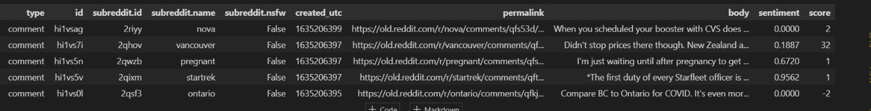
COVID Reddit Dataset
Type: Indicates the type of data, comments or post (we have only used comments due to insufficient access to computational power
ID: Unique identifier for each data entry
Subreddit ID: Unique identifier for the subreddit associated with the post.
Subreddit Name: The name of the subreddit where the post was made.
Subreddit NSFW: Binary indicator (True/False) denoting whether the subreddit is marked as "Not Safe For Work" (NSFW).
Created UTC: Timestamp indicating when the post was created, in Coordinated Universal Time (UTC).
Permalink: URL link to the specific post on Reddit.
Body: The text content of the data entry
Sentiment: The sentiment expressed in the post, often categorized as positive, negative, or neutral.
Score: The Reddit score or popularity measure associated with the post.

Slide 7
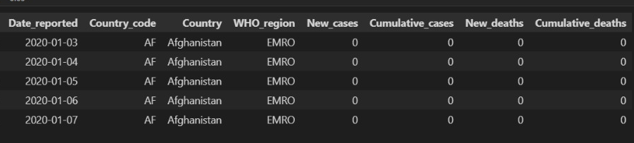
WHO Stats Dataset
Date_reported: The date when the COVID-19 data for a specific country was reported.
Country_code: A unique code assigned to each country for identification purposes.
Country: The name of the country for which the COVID-19 data is reported.
WHO_region: The World Health Organization (WHO) region to which the country belongs.
New_cases: The number of new COVID-19 cases reported on the given date for a specific country.
Cumulative_cases: The total number of confirmed COVID-19 cases in a country up to the reporting date.
New_deaths: The number of new COVID-19 related deaths reported on the given date for a specific country.
Cumulative_deaths: The total number of COVID-19 related deaths in a country up to the reporting date.

Slide 8
Prior Implementations
Linear Regression & Ridge Regression
R square=1
MSE=0
Overfitting
SVR Regression
R square=0.3252
MSE=0.0001
Underfitting
Decision tree ensemble with KNN
R square=0.7224
MSE=0
Good fit
Random Forests
R square=0.7762
MSE=0
Good fit
Cross validation
Average MSE for Ensemble with KNN=0.00003731281110014121
Average MSE for random forest 0.00001946175304530501; since the average MSE for random forest is lower , its performance is better.

Slide 9
Methodology
1. Data Loading and Inspection:
2. Feature Engineering:
3. Sentiment Analysis:
4. Language Complexity Analysis:
5. Combining Data:
6. Outbreak Percentage Calculation:
7. Machine Learning Model (Random Forest Regressor):

Slide 10
Data Loading, Inspection & Feature Engineering
The initial step involves loading essential Python libraries and datasets, aiming to set the foundation for subsequent analysis. Inspection of missing values and dropping irrelevant columns ensures a cleaner dataset for meaningful analysis.
For the feature engineering part of the code, the 'created_utc' column is converted to a datetime format, facilitating the extraction of temporal features. Aggregating comments on a daily basis, aids in summarizing data, providing a more manageable and informative dataset for subsequent analysis.

Slide 11
Sentiment Analysis
Objective:
Extracting emotional tone from comments.
Natural Language Processing (NLP) techniques are used to analyze the sentiment of textual data.
The sentiment scores provide insights into the prevailing public perception and emotional responses related to COVID-19.
The resources used are:-
vader_lexicon
Punkt
Stopwords
The Sentiment Intensity Analyzer (sid) is loaded, which is a pre-trained model for sentiment analysis provided by NLTK.
Performed on Reddit COVID Dataset.

Slide 12
Steps used in Sentiment Analysis
1) tokenize the words
2) get rid of stopwords
3) convert words into lowercase
4) apply the Sentiment Intensity Analyzer model (SID) to get the sentiment scores
Output: Positive sentiment may correlate with optimism or improving conditions, while negative sentiment may indicate concerns or worsening situations.

Slide 13
Language Complexity Analysis & Combining Data
Tracking language complexity over time can help identify patterns related to information dissemination.A sudden change in complexity might indicate a shift in public engagement or the emergence of new topics.These metrics serve as additional features for the machine learning model, contributing to a more nuanced analysis of outbreak dynamics.
Resources used:-
Punkt
Merging daily comments with global COVID-19 statistics aligns data temporally. This integration allows for the exploration of potential relationships between online discussions and disease outbreak dynamics. Temporal alignment is crucial for accurate correlation analysis and prediction model development

Slide 14
Temporal Analysis
Its used to gain a granular understanding of the temporal dynamics of COVID-19
Helps to understand trends, patterns and potential spikes.
We have gone for a daily granularity for the months of September and October 2021
Assumed population of 7.8 billion.
Performed on the WHO Stats dataset

Slide 15
Steps for Temporal Analysis
1)Data preprocessing:
Convert dates into date time format
2)Stats aggregation:
'New_cases': 'sum',
'Cumulative_cases': 'max',
'New_deaths': 'sum',
'Cumulative_deaths': 'max’
3) Percentage Outbreak Calculation:
Cumulative_cases/Total_population*100

Slide 16
Steps for Language Complexity Analysis
1) tokenize comments into sentences and words.
2) calculate average sentence length
avg_sentence_length = len(words) / len(sentences) avg_word_length = sum(len(word) for word in words) / len(words) ttr = len(set(words)) / len(words)
3)percentage outbreak calculation
Cumulative_deaths/ total_population * 100

Slide 17
Machine Leaning Model
The Random Forest Regressor, known for handling complex relationships in data, is employed for its predictive capabilities.
Steps:
1) we use random forest regressor from scikit library
2)parameter used:-
n_estimators=200
max_depth=10
max_features=“sqrt”
random_state=42
3)Model training
4)Model prediction
5)Model evaluation using R Squared and Mean Squared Error

Slide 18
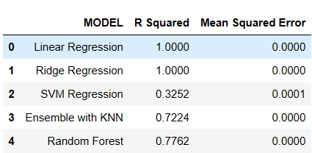
Results and Conclusion

Slide 19
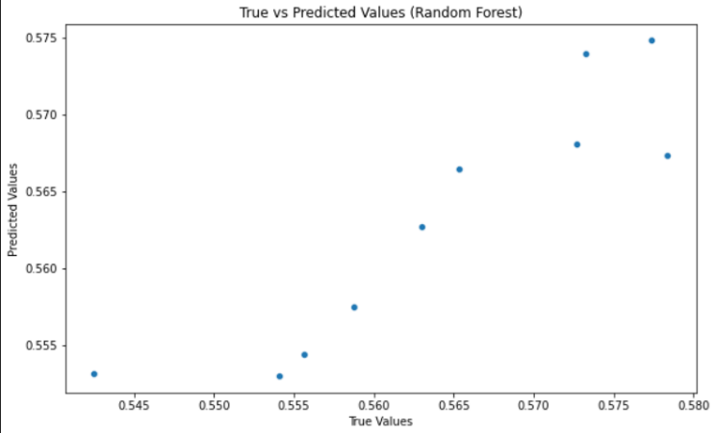
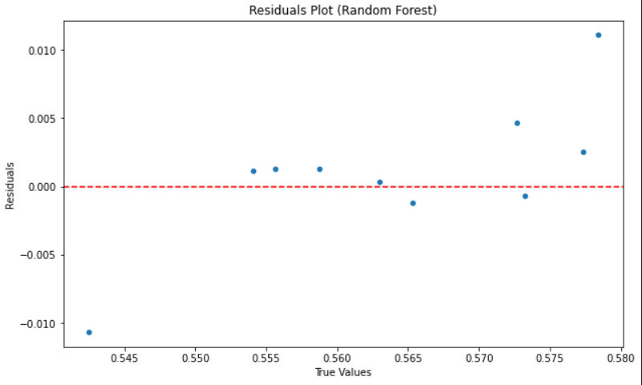

Slide 20
Thank You

